Slide 1

Building the Future of Education: The Student-Teacher Booking System
A comprehensive full-stack web application designed to revolutionize educational appointment management. This system provides a seamless, secure, and efficient platform for students, teachers, and administrators to connect and collaborate.

Slide 2
The Challenge
Unlocking Educational Efficiency
Educational institutions often grapple with outdated and inefficient systems for managing student-teacher interactions. These challenges lead to missed opportunities, administrative burden, and a fragmented learning experience.
Fragmented Communication
Manual Scheduling Inefficiencies
Lack of a centralized platform leads to scattered discussions and missed guidance opportunities.
Paper-based or email booking causes high overhead, conflicts, and missed appointments.
Lack of User Management
Outdated Infrastructure
No centralized authentication or oversight creates security risks and heavy workloads.
Reliance on traditional methods hinders digital transformation and hybrid learning capabilities.

Slide 3
Our Approach
Strategic Solutions for Seamless Learning
We adopted a systematic problem-solving methodology, carefully selecting technologies and designing architecture to address the core challenges of educational appointment management.
Development & Architecture
Technology & Security
3 Distinct User Roles: Admin, Teacher, and Student with specialized dashboards.
Frontend: React.js, Tailwind CSS, React Router DOM for a modern and responsive UI.
Robust Database: 4 MongoDB collections (Users, Appointments, Messages, ChatMessages) ensuring comprehensive data management.
Backend: Node.js, Express.js, MongoDB with Mongoose for robust server-side operations.
Real-Time Communication: Socket.io for chat and WebRTC for video calls.
RESTful API Design: 15+ endpoints across 4 route categories for secure and efficient data flow.
Security: JWT authentication, bcryptjs password hashing, and role-based middleware.
Our design prioritizes a modern glass morphism aesthetic, ensuring a visually appealing and intuitive user experience across all devices.

Slide 4
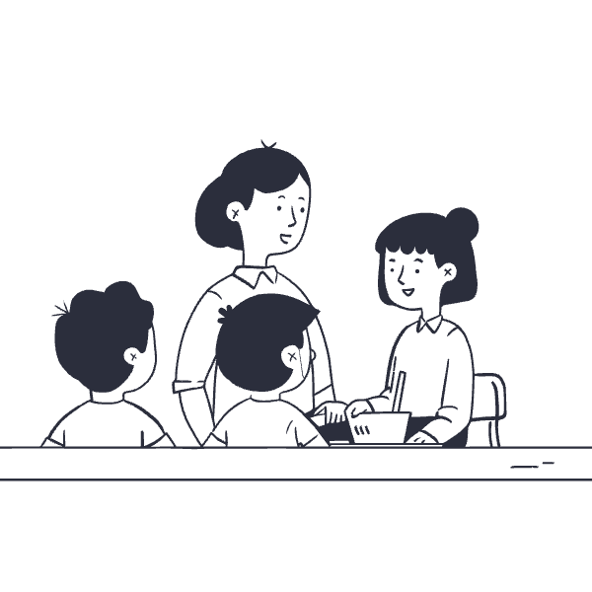



Key Features
Transforming Challenges into Capabilities
Our Student-Teacher Booking System directly tackles identified problems with innovative technical features, delivering a holistic solution for modern educational environments.
Real-time Communication
Automated Scheduling
Problem Addressed: Communication fragmentation.
Problem Addressed: Manual scheduling inefficiencies.
Socket.io server enables instant chat within appointment rooms.
Intuitive date and time selection with real-time availability.
Persistent chat history stored in MongoDB for context.
Teacher approval/rejection workflow for bookings.
WebRTC (Simple-peer) integrates seamless video calling.
Automated conflict prevention and real-time updates.
Role-Based Access Control
Modern Digital Infrastructure
Problem Addressed: Lack of systematic user management.
Problem Addressed: Absence of modern digital infrastructure.
Secure JWT-based authentication for distinct user roles.
Full MERN stack application with responsive UI.
Role-specific middleware ensures authorized access.
Glass morphism design for a sleek, contemporary look.
Admin approval workflow for new student accounts.
Enables remote consultations and hybrid learning models.

Slide 5


Outcomes
Measurable Success, Enhanced Value
The Student-Teacher Booking System delivers robust functionality, technical excellence, and significant business value, demonstrating its capacity to transform educational operations.
15+
100%
REST APIs
Secured Endpoints
Driving comprehensive data interactions and system functions.
Ensuring data integrity and user privacy through robust security.
3000
2000
Lines of Frontend Code
Lines of Backend Code
Crafting a rich, interactive user experience.
Powering efficient data processing and server logic.
The system successfully achieved seamless communication, automated scheduling, and secure user management, leading to:
Reduced manual coordination and administrative overhead.
Centralized communication and enhanced collaboration.
Robust support for remote and hybrid learning environments.
Improved data-driven insights into appointment trends.

Slide 6

Conclusion
A New Era for Educational Consultations
The Student-Teacher Booking System represents a complete, technically excellent solution addressing critical challenges in educational appointment management.
Holistic Solution: Integrates MERN stack with real-time communication (Socket.io, WebRTC) for a comprehensive platform.
Technical Prowess: Showcases proficiency in full-stack development, database design, UI/UX, and security best practices.
Scalable Architecture: Modular design and REST API support horizontal scaling and concurrent users, making it production-ready.
Tangible Impact: Eliminates manual inefficiencies, enhances communication, and streamlines management for all stakeholders.
This system is more than just a booking tool; it's a foundation for a more connected, efficient, and future-ready educational ecosystem.

